Slide 1
Math 170 Functions, Data, and Models
43 Compositions
Section 10.1

Slide 2
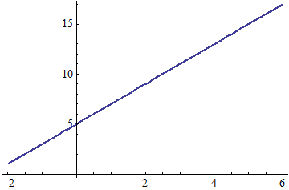
Review
A function is
A function can be expressed with
Special types of functions include
Let $f\left(x\right)=x^{2}−2x$. Find a graph for $f$.
Let $g$ be defined by the graph. Find a formula for $g$.

Slide 3
Review Answers
A function is a rule that assigns to each possible input exactly one output.
A function can be expressed with words, tables, graphs, or formulas.
Special types of functions include linear, quadratic, exponential, logarithmic, and trigonometric.

Slide 4
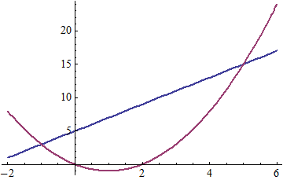

Review Answers
Let $f\left(x\right)=x^{2}−2x$. Find a graph for $f$.
$g\left(x\right)=2x+5$

Slide 5
Function Composition
If $f$ and $g$ are functions, then $g_{°}f$ (read “g composed with f”) is the function defined by ${(g}_{°}f)\left(x\right)=g(f\left(x\right))$, that is, for an input $x$, find $t=f(x)$, and use $t$ to find $g(t)$, which is the output.
Let $f\left(x\right)=x^{2}−2x$ and $g\left(t\right)=2t+5$.
Find $(g_{°}f)(4)$.
Find $(g_{°}f)(1)$.
Find $(f_{°}g)(4)$.
Find $(g_{°}f)(x)$.
Find $(f_{°}g)(t)$.
Find $(f_{°}f)(x)$.

Slide 6
Function Composition Answers
If $f$ and $g$ are functions, then $g_{°}f$ (read “g composed with f”) is the function defined by ${(g}_{°}f)\left(x\right)=g(f\left(x\right))$, that is, for an input $x$, find $t=f(x)$, and use $t$ to find $g(t)$, which is the output.
Let $f\left(x\right)=x^{2}−2x$ and $g\left(t\right)=2t+5$.
Find $\left(g_{°}f\right)\left(4\right)=g\left(f\left(4\right)\right)=g\left(8\right)=21$.
Find $\left(g_{°}f\right)\left(1\right)=g\left(f\left(1\right)\right)=g\left(−1\right)=3$.
Find $\left(f_{°}g\right)\left(4\right)=f\left(g\left(4\right)\right)=f\left(13\right)=143$.
Find $\left(g_{°}f\right)\left(x\right)=g\left(f\left(x\right)\right)=g\left(x^{2}−2x\right)=2\left(x^{2}−2x\right)+5=2x^{2}−4x+5$ or $\left(g_{°}f\right)\left(x\right)=g\left(f\left(x\right)\right)=2f\left(x\right)+5=2\left(x^{2}−2x\right)+5=2x^{2}−4x+5$.
Find $\left(f_{°}g\right)\left(t\right)=f\left(g\left(t\right)\right)=f\left(2t+5\right)={(2t+5)}^{2}−2\left(2t+5\right)=4t^{2}+6t+15$.
Find $\left(f_{°}f\right)\left(x\right)=f\left(f\left(x\right)\right)={f(x)}^{2}−2f\left(x\right)={\left(x^{2}−2x\right)}^{2}−2\left(x^{2}−2x\right)=x^{4}−4x^{3}+2x^{2}−4x$.

Slide 7
Table Composition
Remember ${(g}_{°}f)\left(x\right)=g(f\left(x\right))$.
Fill in the table.
x | 1 | 2 | 3 | 4 | 5 | 6
f(x) | 4 | 3 | 5 | 2 | 3
g(x) | 3 | 4 | 0 | 2 | 1
g(f(x)) |  |  |  |  |  | 3
f(g(x)) |  |  |  |  |  | 3
f(f(x))

Slide 8
Table Composition Answers
Remember ${(g}_{°}f)\left(x\right)=g(f\left(x\right))$.
Fill in the table.
x | 1 | 2 | 3 | 4 | 5 | 6
f(x) | 4 | 3 | 5 | 2 | 3 | 1
g(x) | 3 | 4 | 0 | 2 | 1 | 2 or 5
g(f(x)) | 2 | 0 | 1 | 4 | 0 | 3
f(g(x)) | 5 | 2 | not def. | 3 | 4 | 3
f(f(x)) | 2 | 5 | 3 | 3 | 5 | 4

Slide 9
Word Composition
Remember ${(g}_{°}f)\left(x\right)=g(f\left(x\right))$.
Suppose that oil is leaking out of a damaged tanker. The oil is forming a circular-shaped slick on the surface of the water. Suppose that the radius $t$ hours after the leak began is given by $f\left(t\right)=300t$ meters. The area of a circle as a function of its radius is $g\left(r\right)=_______$.
Find a formula for $g_{°}f$.
Write words to describe $g_{°}f$.
If the slick is estimated to have an area of ten million square meters, then how many hours has the oil been leaking?

Slide 10
Word Composition Answers
Remember ${(g}_{°}f)\left(x\right)=g(f\left(x\right))$.
Suppose that oil is leaking out of a damaged tanker. The oil is forming a circular-shaped slick on the surface of the water. Suppose that the radius $t$ hours after the leak began is given by $f\left(t\right)=300t$ meters. The area of a circle as a function of its radius is $g\left(r\right)=πr^{2}$ square meters.
$\left(g_{°}f\right)\left(t\right)=π{(300t)}^{2}$.
$\left(g_{°}f\right)\left(t\right)$ is the area, in square meters, of the oil slick $t$ hours after the leak began.
$π{(300t)}^{2}={10}^{7}$ implies $t=\frac{1}{300}\sqrt{{10}^{7}/π} ≈5.95$ hours

Slide 11
Decomposition
Remember ${(g}_{°}f)\left(x\right)=g(f\left(x\right))$.
Decompose $h\left(x\right)=\sin{(x^{2}+3)}$ into two or more functions.
$g\left(t\right)=\sin{t}$ and $f\left(x\right)=x^{2}+3$
$g\left(t\right)=\sin{(t+3)}$ and $f\left(x\right)=x^{2}$
$g\left(t\right)=\sin{(t^{2}+3)}$ and $f\left(x\right)=x$
$g\left(t\right)=\sin{t}$, $f\left(y\right)=y+3$, and $s\left(x\right)=x^{z2}$

Slide 12
Decomposition
Remember ${(g}_{°}f)\left(x\right)=g(f\left(x\right))$.
Decompose $h\left(x\right)=\sin{(x^{2}+3)}$ into two or more functions.

Slide 13
Decomposition - Answers
Remember ${(g}_{°}f)\left(x\right)=g(f\left(x\right))$.
Decompose $h\left(x\right)=\sin{(x^{2}+3)}$ into two or more functions.
$g\left(t\right)=\sin{t}$ and $f\left(x\right)=x^{2}+3$
$g\left(t\right)=\sin{(t+3)}$ and $f\left(x\right)=x^{2}$
$g\left(t\right)=\sin{(t^{2}+3)}$ and $f\left(x\right)=x$
$g\left(t\right)=\sin{t}$, $f\left(y\right)=y+3$, and $s\left(x\right)=x^{2}$

Slide 14
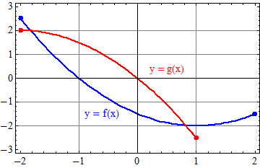
Graph Composition
What is the domain and range of $f$?
What is the domain and range of $g$?
Graph $g_{°}f$.
Graph $f_{°}g$.

Slide 15
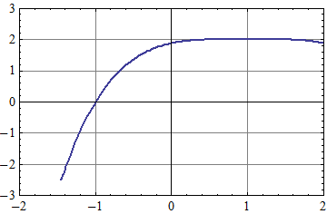
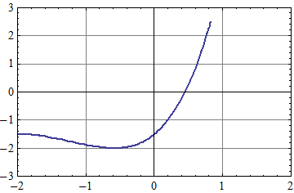
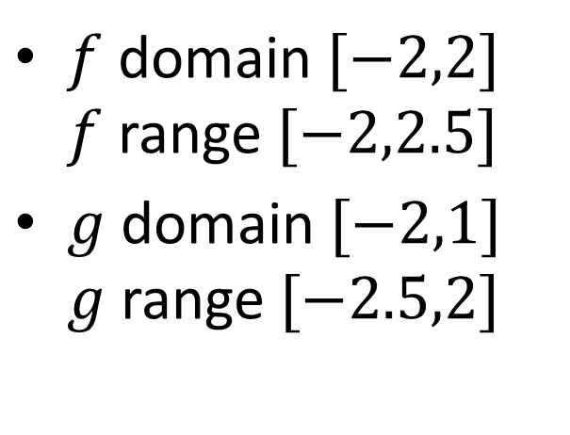
Graph Composition Answers
$$g_{°}f$$
$f$ domain $[−2,2]$ $f$ range $[−2,2.5]$
$g$ domain $[−2,1]$ $g$ range $[−2.5,2]$
$$f_{°}g$$

